Slide 1


Advanced Programming 2 Flight Remote Control Android App
Shlomi Ben-Shushan
Computer Science, Bar-Ilan University

Slide 2

Submission Details
Student: Shlomi Ben-Shushan
Lecturer: Dr. Eliyahu Khalastche
Course: Advanced Programming 2 – 89-211-01
Institution: Department of Computer Science, Bar-Ilan University
Date: June 2021

Slide 3

Introduction
The App: Android based Flight Remote Control for FlightGear simulator.
Kotlin
Android Studio
GitHub: https://github.com/shlomi1993/FlightSimulatorAndroidApp
System Requirements:
Android device with Android 11.0 x86 OS – Tested on Pixel XL API 30 and Samsung Galaxy S20 device.
FlightGear simulator – Download here: https://www.flightgear.org/download/

Slide 4
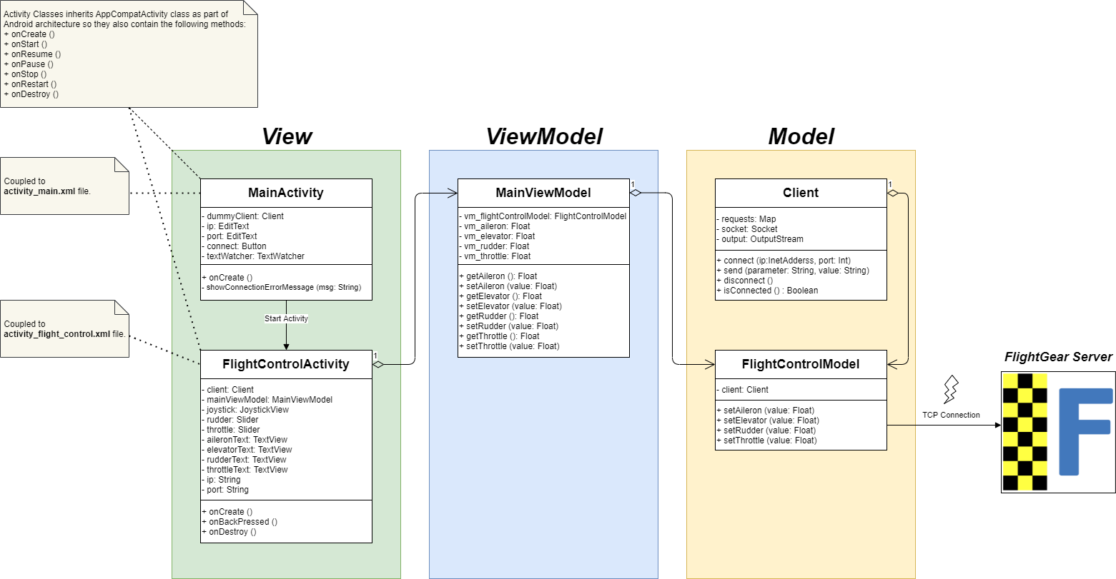
Class Diagram (MVVM)

Slide 5
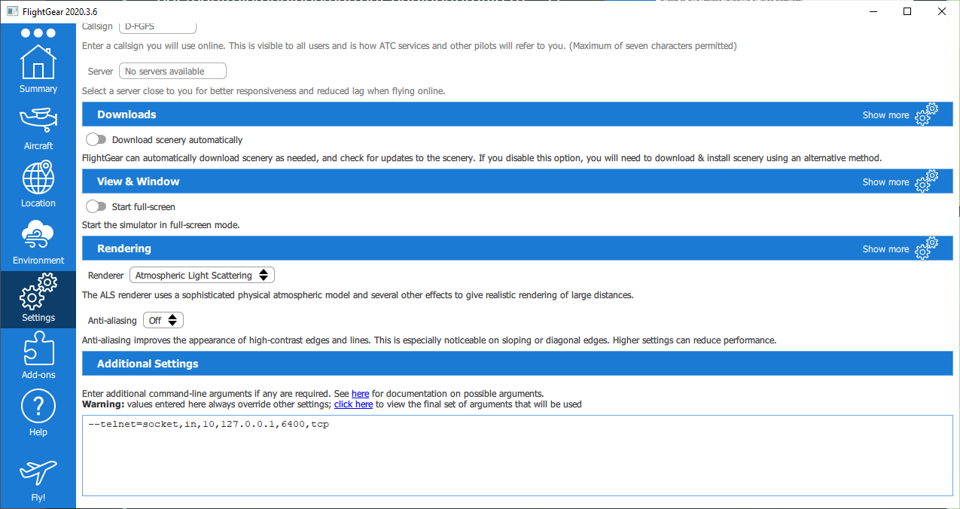
FlightGear Server Settings
1
2

Slide 6
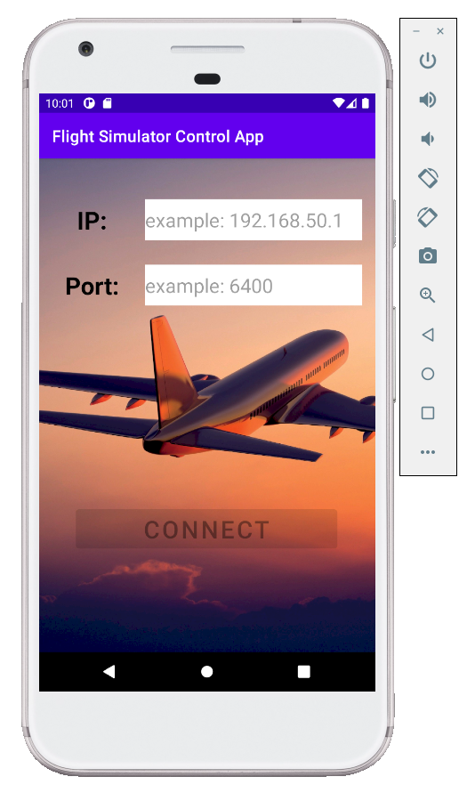
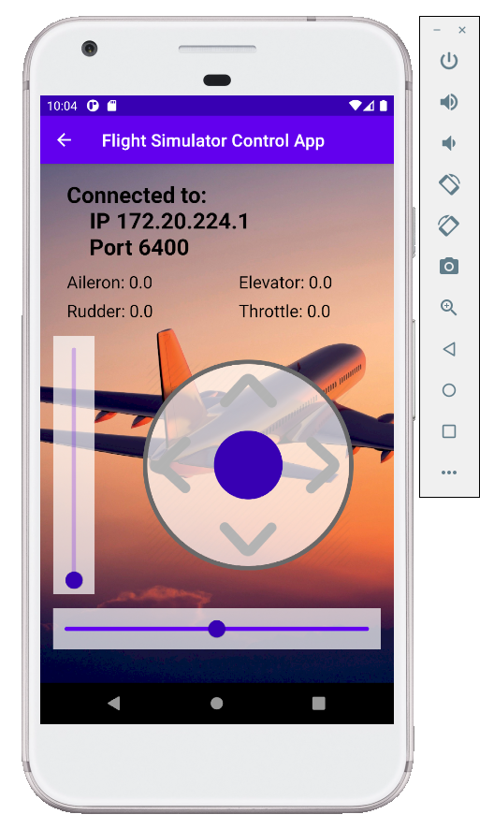

Main Activity $→$ Flight Control Activity

Slide 7
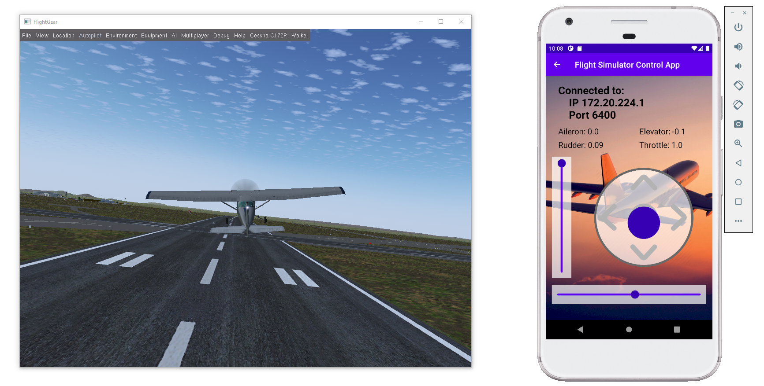
Controlling the Aircraft

Slide 8
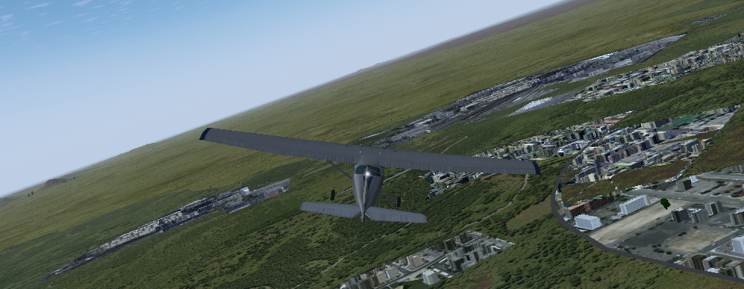
Demo

